Slide 1
Regression Analysis

Slide 2
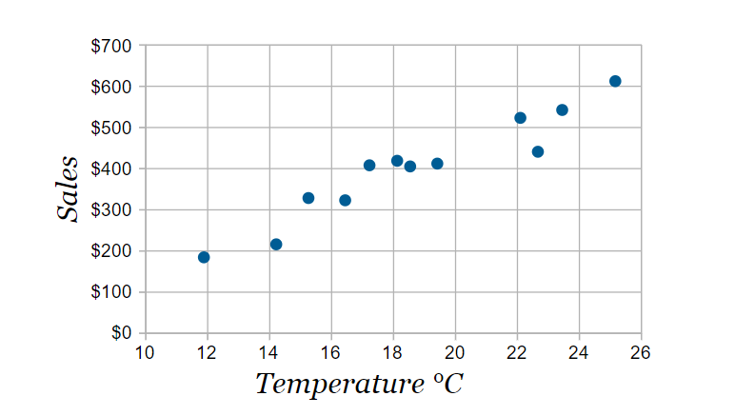

Simple Linear Regression Model
Assume that we can use variable $X$ and its different values/levels $x_{i}$s to predict/estimate $Y$. As in a popular example, the sales of ice cream might be predictable using temperature, as shown below.

Slide 3

Simple Linear Regression Model
In SLR, it is assumed that
$$Y_{i}= μ_{Y|x_{i}}+ε_{i}$$
$$μ_{Y|x_{i}}=β_{0}+β_{1}x_{i}$$
$$Y_{i}=β_{0}+β_{1}x_{i}+ε_{i}$$
$β_{0}$ and $β_{1}$ are the parameters to be estimated.
Note: ${ Y}_{i} \sim N(β_{0}+β_{1}x_{i},σ^{2})$

Slide 4
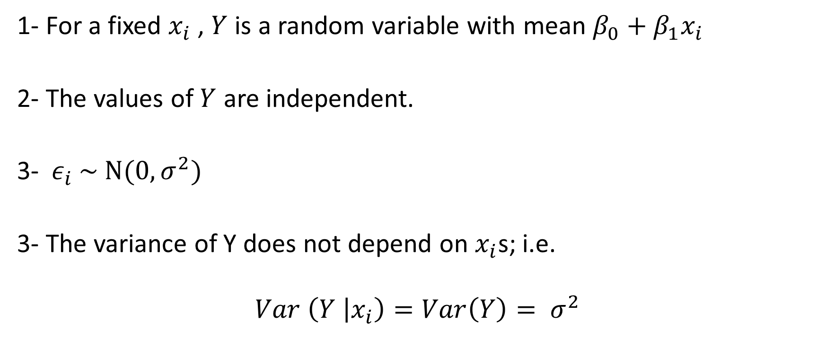
Assumptions of the SLR Model
1- For a fixed $x_{i}$ , $Y$ is a random variable with mean $β_{0}+β_{1}x_{i}$
2- The values of $Y$ are independent.
3-${ ε}_{i} \sim N(0,σ^{2})$
3- The variance of Y does not depend on $x_{i}$s; i.e.
$$Var \left(Y | x_{i}\right)=Var\left(Y\right)= σ^{2}$$

Slide 5
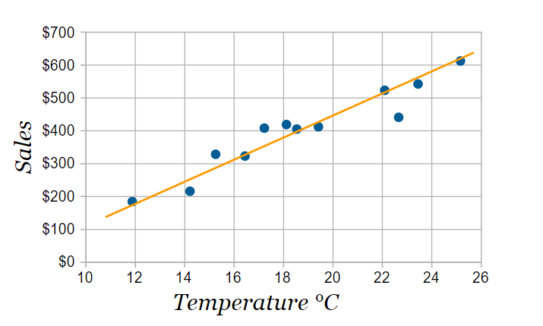
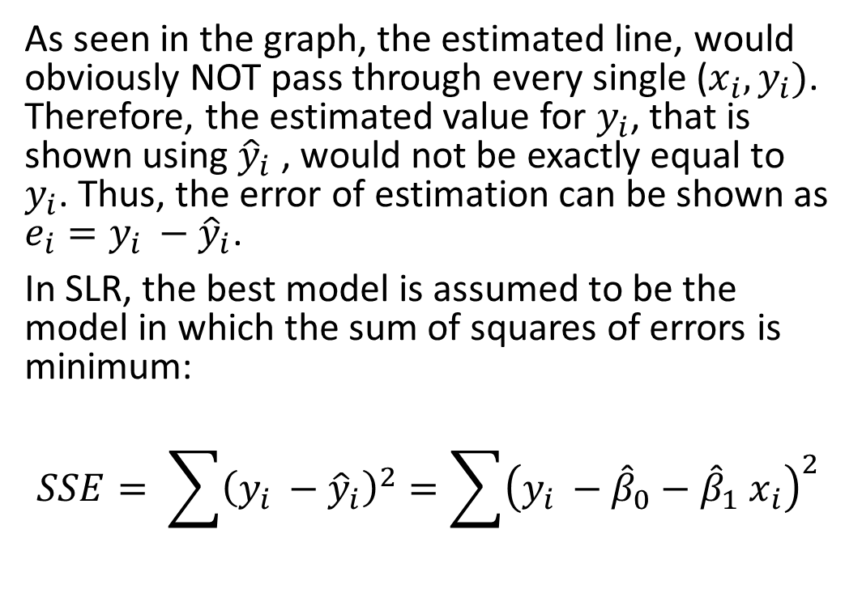
Parameter Estimation for the SLR Model
As seen in the graph, the estimated line, would obviously NOT pass through every single ($x_{i}, y_{i})$. Therefore, the estimated value for $y_{i}$, that is shown using ${\hat{y}}_{i}$ , would not be exactly equal to $y_{i}$. Thus, the error of estimation can be shown as $e_{i}=y_{i }−{\hat{y}}_{i}$.
In SLR, the best model is assumed to be the model in which the sum of squares of errors is minimum:
$$SSE= \sum{{\left(y_{i }−{\hat{y}}_{i}\right)}^{2}}=\sum{{\left(y_{i }−{\hat{β}}_{0}−{\hat{β}}_{1}{ x}_{i}\right)}^{2}}$$

Slide 6

Parameter Estimation for the SLR Model
This gives us
$${\hat{β}}_{0}= \overline{y}−{\hat{β}}_{1}\overline{x}$$
$${\hat{β}}_{1}= \frac{\sum{(x_{i}−\overline{x})(y_{i}−\overline{y})}}{\sum{{(x_{i}−\overline{x})}^{2}}}= \frac{S_{xy}}{S_{xx}}$$
Note:
$$\sum{(x_{i}−\overline{x})(y_{i}−\overline{y})}=\sum{(x_{i}−\overline{x})y_{i}}=\sum{x_{i}(y_{i}−\overline{y})}$$

